Slide 1

Artificial Intelligence (AI-2002)
Anaum Hamid
ML- Classification and Regression

Slide 2
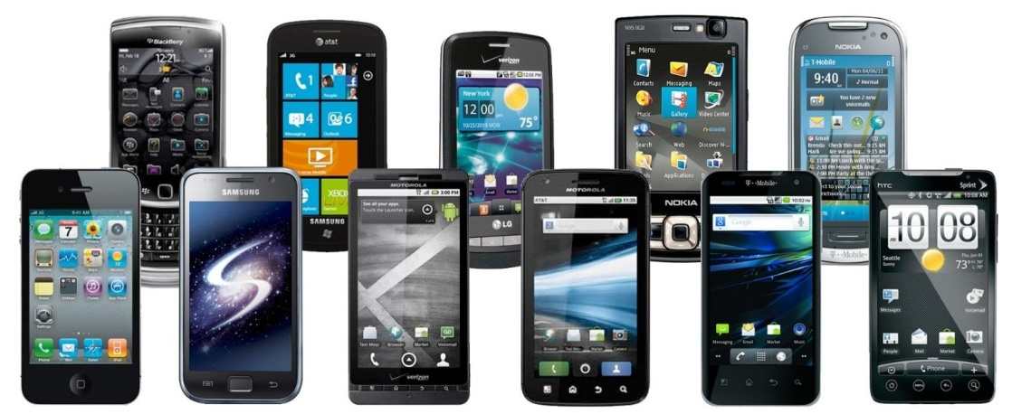
Gentle Reminder
“Switch Off” your Mobile Phone Or Switch Mobile Phone to “Silent Mode”

Slide 3
Contents
1. Classification Vs. Prediction
3. Bayesian Classification
5. Using IF-THEN Rules
2. Decision Tree Induction
6. Prediction
7. Classifier Accuracy
4. K-Nearest Neighbourhood

Slide 4
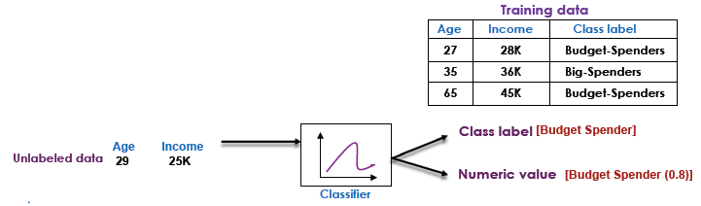
Definition
Classification is also called Supervised Learning
Supervision
The training data (observations, measurements, etc) are used to learn a classifier
The training data are labeled data
New data (unlabeled) are classified Using the training data
Principle
Construct models (functions) based on some training examples
Describe and distinguish classes or concepts for future prediction
Predict some unknown class labels

Slide 5






Classification vs. Prediction
Classification
Predicts categorical class labels (discrete or nominal)
Use labels of the training data to classify new data
Example
A model or classifier is constructed to predict categorical labels such as “safe” or “risky” for a loan application data.
Prediction
Models continuous-valued functions, i.e., predicts unknown or missing values
Example
A marketing manager would like to predict how much a given costumer will spend during a sale
Unlike classification, it provides ordered values
Regression analysis is used for prediction
Prediction is a short name for
numeric prediction
Will buy a computer
Classifier
Will not
Customer profile
Numeric Prediction
Customer profile
150 Euro

Slide 6
Applications
Typical applications
Credit approval
Target marketing
Medical diagnosis
Treatment effectiveness analysis
Fraud detection
Defective parts identification in manufacturing
Crime zoning

Slide 7
Classification—A Three-Step Process
Model construction: describing a set of predetermined classes
Each tuple/sample is assumed to belong to a predefined class, as determined by the class label attribute
The set of tuples used for model construction is training set
The model is represented as classification rules, decision trees, or mathematical formulae
Test Classifier (Estimate accuracy of the model)
The known label of test sample is compared with the classified result from the model
Accuracy rate is the percentage of test set samples that are correctly classified by the model
Test set is independent of training set, otherwise over-fitting will occur
Model usage: for classifying future or unknown objects
If the accuracy is acceptable, use the model to classify data tuples whose class labels are not known

Slide 8
Process (1): Model Construction
Classification
Algorithms
Training
Data
Classifier
(Model)
IF rank = ‘professor’
OR years > 6
THEN tenured = ‘yes’

Slide 9
Process (2&3): Test and Using the Model in Prediction
Classifier
Testing
Data
Unseen Data
(Jeff, Professor, 4)
Tenured?

Slide 10
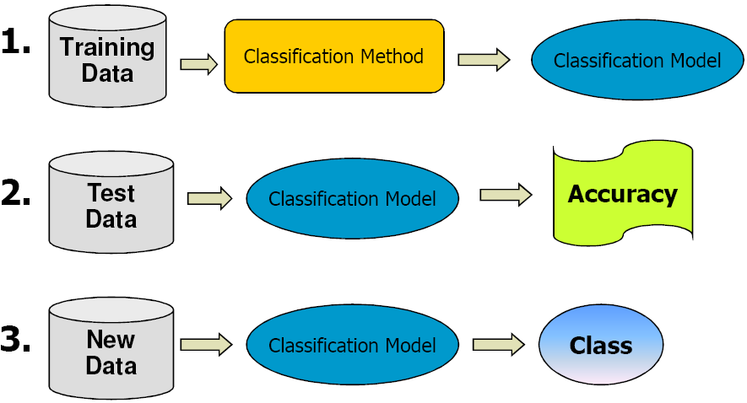
Classification—A Three-Step Process

Slide 11
Supervised vs. Unsupervised Learning
Supervised learning (classification)
Supervision: The training data (observations, measurements, etc.) are accompanied by labels indicating the class of the observations
New data is classified based on the training set
Unsupervised learning (clustering)
The class labels of training data is unknown
Given a set of measurements, observations, etc. with the aim of establishing the existence of classes or clusters in the data

Slide 12
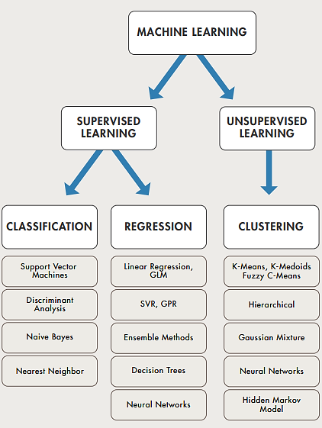

Slide 13
Issues: Data Preparation
Data cleaning
Preprocess data in order to reduce noise and handle missing values
Relevance analysis (feature selection)
Remove the irrelevant or redundant attributes
Data transformation
Generalize and/or normalize data

Slide 14
Issues: Evaluating Classification Methods
Accuracy
classifier accuracy: predicting class label
predictor accuracy: guessing value of predicted attributes
Speed
time to construct the model (training time)
time to use the model (classification/prediction time)
Robustness: handling noise and missing values
Scalability: efficiency in disk-resident databases
Interpretability
understanding and insight provided by the model
Other measures, e.g., goodness of rules, such as decision tree size or compactness of classification rules

Slide 15
Decision Tree Induction: Training Dataset
This follows an example of (Buy Computer)

Slide 16
Output: A Decision Tree for “buys_computer”
age?
<=30
>40
31..40
student?
yes
credit rating?
no
yes
excellent
fair
no
yes
no
yes

Slide 17
Algorithm for Decision Tree Induction
Basic algorithm (a greedy algorithm)
Tree is constructed in a top-down recursive divide-and-conquer manner
At start, all the training examples are at the root
Attributes are categorical (if continuous-valued, they are discretized in advance)
Examples are partitioned recursively based on selected attributes
Test attributes are selected on the basis of a heuristic or statistical measure (e.g., information gain, gain ratio, gini index)
Conditions for stopping partitioning
All samples for a given node belong to the same class
There are no remaining attributes for further partitioning – majority voting is employed for classifying the leaf
There are no samples left

Slide 18
Attribute Selection Measure: Information Gain (ID3/C4.5)
Select the attribute with the highest information gain
Let p_{i} be the probability that an arbitrary tuple in D belongs to class C_{i}, estimated by |C_{i, D}|/|D|
Expected information (entropy) needed to classify a tuple in D:
Information needed (after using A to split D into v partitions) to classify D:
Information gained by branching on attribute A
Notes:
I : the expected information needed to classify a given sample
E (entropy) : expected information based on the partitioning into subsets by A

Slide 19
Attribute Selection: Information Gain
Class P: buys_computer = “yes”
Class N: buys_computer = “no”
means “age <=30” has 5 out of 14 samples, with 2 yes’es and 3 no’s. Hence
Similarly,

Slide 20
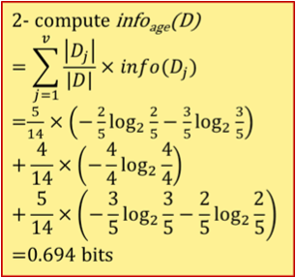
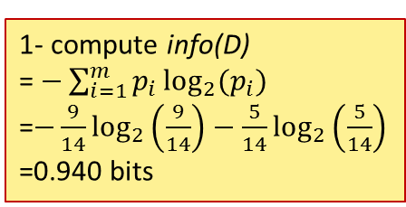
Attribute Selection: Information Gain
RID | age | income | student | Credit_rating | Class: buys_computer
1 | <=30 | high | no | fair | no
2 | <=30 | high | no | excellent | no
3 | 31…40 | high | no | fair | yes
4 | >40 | medium | no | fair | yes
5 | >40 | low | yes | fair | yes
6 | >40 | low | yes | excellent | no
7 | 31…40 | low | yes | excellent | yes
8 | <=30 | medium | no | fair | no
9 | <=30 | low | yes | fair | yes
10 | >40 | medium | yes | fair | yes
11 | <=30 | medium | yes | excellent | yes
12 | 31…40 | medium | no | excellent | yes
13 | 31…40 | high | yes | fair | yes
14 | >40 | medium | no | excellent | no
C₁ = Yes = 9
C₂ = No = 5
1- compute info(D)
= $−\sum_{i=1}^{m}{p_{i}\log_{2}{(p_{i})}}$
=$−\frac{9}{14}\log_{2}\left(\frac{9}{14}\right)−\frac{5}{14}\log_{2}\left(\frac{5}{14}\right)$
=0.940 bits

Slide 21
Attribute Selection: Information Gain
RID | age | income | student | Credit_rating | Class: buys_computer
1 | <=30 | high | no | fair | no
2 | <=30 | high | no | excellent | no
3 | 31…40 | high | no | fair | yes
4 | >40 | medium | no | fair | yes
5 | >40 | low | yes | fair | yes
6 | >40 | low | yes | excellent | no
7 | 31…40 | low | yes | excellent | yes
8 | <=30 | medium | no | fair | no
9 | <=30 | low | yes | fair | yes
10 | >40 | medium | yes | fair | yes
11 | <=30 | medium | yes | excellent | yes
12 | 31…40 | medium | no | excellent | yes
13 | 31…40 | high | yes | fair | yes
14 | >40 | medium | no | excellent | no
C₁ = Yes = 9
C₂ = No = 5
1- compute info(D)
= $−\sum_{i=1}^{m}{p_{i}\log_{2}{(p_{i})}}$
=$−\frac{9}{14}\log_{2}\left(\frac{9}{14}\right)−\frac{5}{14}\log_{2}\left(\frac{5}{14}\right)$
=0.940 bits

Slide 22
Attribute Selection: Information Gain
RID | age | income | student | Credit_rating | Class: buys_computer
1 | <=30 | high | no | fair | no
2 | <=30 | high | no | excellent | no
3 | 31…40 | high | no | fair | yes
4 | >40 | medium | no | fair | yes
5 | >40 | low | yes | fair | yes
6 | >40 | low | yes | excellent | no
7 | 31…40 | low | yes | excellent | yes
8 | <=30 | medium | no | fair | no
9 | <=30 | low | yes | fair | yes
10 | >40 | medium | yes | fair | yes
11 | <=30 | medium | yes | excellent | yes
12 | 31…40 | medium | no | excellent | yes
13 | 31…40 | high | yes | fair | yes
14 | >40 | medium | no | excellent | no
C₁ = Yes = 9
C₂ = No = 5
1- compute info(D)
= $−\sum_{i=1}^{m}{p_{i}\log_{2}{(p_{i})}}$
=$−\frac{9}{14}\log_{2}\left(\frac{9}{14}\right)−\frac{5}{14}\log_{2}\left(\frac{5}{14}\right)$
=0.940 bits

Slide 23
Attribute Selection: Information Gain
RID | age | income | student | Credit_rating | Class: buys_computer
1 | <=30 | high | no | fair | no
2 | <=30 | high | no | excellent | no
3 | 31…40 | high | no | fair | yes
4 | >40 | medium | no | fair | yes
5 | >40 | low | yes | fair | yes
6 | >40 | low | yes | excellent | no
7 | 31…40 | low | yes | excellent | yes
8 | <=30 | medium | no | fair | no
9 | <=30 | low | yes | fair | yes
10 | >40 | medium | yes | fair | yes
11 | <=30 | medium | yes | excellent | yes
12 | 31…40 | medium | no | excellent | yes
13 | 31…40 | high | yes | fair | yes
14 | >40 | medium | no | excellent | no
C₁ = Yes = 9
C₂ = No = 5
1- compute info(D)
= $−\sum_{i=1}^{m}{p_{i}\log_{2}{(p_{i})}}$
=$−\frac{9}{14}\log_{2}\left(\frac{9}{14}\right)−\frac{5}{14}\log_{2}\left(\frac{5}{14}\right)$
=0.940 bits
3- compute Gain(age) = 0.94 - 0.694 = 0.246 bits

Slide 24
Attribute Selection: Information Gain
RID | age | income | student | Credit_rating | Class: buys_computer
1 | <=30 | high | no | fair | no
2 | <=30 | high | no | excellent | no
3 | 31…40 | high | no | fair | yes
4 | >40 | medium | no | fair | yes
5 | >40 | low | yes | fair | yes
6 | >40 | low | yes | excellent | no
7 | 31…40 | low | yes | excellent | yes
8 | <=30 | medium | no | fair | no
9 | <=30 | low | yes | fair | yes
10 | >40 | medium | yes | fair | yes
11 | <=30 | medium | yes | excellent | yes
12 | 31…40 | medium | no | excellent | yes
13 | 31…40 | high | yes | fair | yes
14 | >40 | medium | no | excellent | no
Gain(age) = 0.246 bits
Gain(income) = 0.029 bits
Gain(student) = 0.151 bits
Gain(credit_rating) = 0.048 bits
Gain(age) has highest information gain

Slide 25
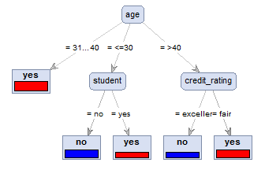
Attribute Selection: Information Gain
age | income | student | credit_rating | buys_computer
<=30 | high | no | fair | no
<=30 | high | no | excellent | no
31…40 | high | no | fair | yes
>40 | medium | no | fair | yes
>40 | low | yes | fair | yes
>40 | low | yes | excellent | no
31…40 | low | yes | excellent | yes
<=30 | medium | no | fair | no
<=30 | low | yes | fair | yes
>40 | medium | yes | fair | yes
<=30 | medium | yes | excellent | yes
31…40 | medium | no | excellent | yes
31…40 | high | yes | fair | yes
>40 | medium | no | excellent | no
Training data set: Buys_computer

Slide 26
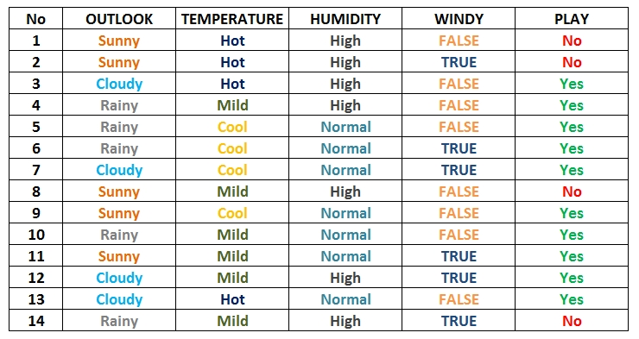
Practice : Training Data

Slide 27
Practice: Training Data ( Entropy Calculations)
Entropy Total
Entropy (Outlook)
Entropy (Temperature)
Entropy (Humidity)
Entropy (Windy)

Slide 28
Bayesian Classification: Why?
A statistical classifier: performs probabilistic prediction, i.e., predicts class membership probabilities
Foundation: Based on Bayes’ Theorem.
Performance: A simple Bayesian classifier, naïve Bayesian classifier, has comparable performance with decision tree and selected neural network classifiers
Incremental: Each training example can incrementally increase/decrease the probability that a hypothesis is correct — prior knowledge can be combined with observed data
Standard: Even when Bayesian methods are computationally intractable, they can provide a standard of optimal decision making against which other methods can be measured

Slide 29
Bayesian Theorem: Basics
Let X be a data sample (“evidence”): class label is unknown
Let H be a hypothesis that X belongs to class C
Classification is to determine P(H|X), the probability that the hypothesis holds given the observed data sample X
P(H) (prior probability), the initial probability
E.g., X will buy computer, regardless of age, income, …
P(X): probability that sample data is observed
P(X|H) (posteriori probability), the probability of observing the sample X, given that the hypothesis holds
E.g., Given that X will buy computer, the prob. that X is 31..40, medium income

Slide 30
Bayesian Theorem
Given training data X, posteriori probability of a hypothesis H, P(H|X), follows the Bayes theorem
Informally, this can be written as
posteriori = likelihood x prior/evidence
Predicts X belongs to C₂ iff the probability P(C_{i}|X) is the highest among all the P(C_{k}|X) for all the k classes
Practical difficulty: require initial knowledge of many probabilities, significant computational cost
Notes:
P(H) : Prior probability of hypothesis H
P(X) : Prior probability of training data X
P(H/X) : Probability of H given X
P(X/H) : Probability of X given H

Slide 31
Towards Naïve Bayesian Classifier
Let D be a training set of tuples and their associated class labels, and each tuple is represented by an n-D attribute vector X = (x₁, x₂, …, x_{n})
Suppose there are m classes C₁, C₂, …, C_{m}.
Classification is to derive the maximum posteriori, i.e., the maximal P(C_{i}|X)
This can be derived from Bayes’ theorem
Since P(X) is constant for all classes, only
needs to be maximized

Slide 32
Derivation of Naïve Bayes Classifier
A simplified assumption: attributes are conditionally independent (i.e., no dependence relation between attributes):
This greatly reduces the computation cost: Only counts the class distribution
If A_{k} is categorical, P(x_{k}|C_{i}) is the # of tuples in C_{i} having value x_{k} for A_{k} divided by |C_{i, D}| (# of tuples of C_{i} in D)
If A_{k} is continous-valued, P(x_{k}|C_{i}) is usually computed based on Gaussian distribution with a mean μ and standard deviation σ
and P(x_{k}|C_{i}) is

Slide 33
Naïve Bayesian Classifier: Training Dataset
Class:
C₁:buys_computer = ‘yes’
C₂:buys_computer = ‘no’
Data to be classified:
X = (age <=30,
income = medium,
student = yes,
credit_rating = fair)
X → buy computer?

Slide 34
Naïve Bayesian Classifier: An Example
X = (age <= 30 , income = medium, student = yes, credit_rating = fair)
Likelihood of “yes” = 2/9 x 4/9 x 6/9 x 6/9 X 9/14
= 0.02821
Likelihood of “no” = 3/5 x 2/5 x 1/5 x 2/5 X 5/14 = 0.0068
Turn into probability by normalizing likelihood values
probability of “yes” = 0.02821 / (0.02821 + 0.0068)
= 0.8057
probability of “no” = 0.0068 / (0.02821 + 0.0068)
= 0.1942
age | income | student | credit_rating | buys_computer
<=30 | high | no | fair | no
<=30 | high | no | excellent | no
31…40 | high | no | fair | yes
>40 | medium | no | fair | yes
>40 | low | yes | fair | yes
>40 | low | yes | excellent | no
31…40 | low | yes | excellent | yes
<=30 | medium | no | fair | no
<=30 | low | yes | fair | yes
>40 | medium | yes | fair | yes
<=30 | medium | yes | excellent | yes
31…40 | medium | no | excellent | yes
31…40 | high | yes | fair | yes
>40 | medium | no | excellent | no
age |  |  | Income |  |  | Student |  |  | Credit Rating |  |  | Buys_Computer
 | Yes | No |  | Yes | No |  | Yes | No |  | Yes | No | Yes | No
<=30 | 2/9 | 3/5 | High | 2/9 | 2/5 | Yes | 6/9 | 1/5 | Excellent | 3/9 | 3/5 | 9/14 | 5/14
31..40 | 4/9 | 0/5 | Medium | 4/9 | 2/5 | No | 3/9 | 4/5 | Fair | 6/9 | 2/5
>40 | 3/9 | 2/5 | Low | 3/9 | 1/5
probability of “yes” is 0.8057 therefore X belongs to (“buy_computer = yes”)

Slide 35
Naïve Bayesian Classifier: Exercise
The given data belongs to which class (mammals/non-mammals)?
Use Naïve Bayesian classifier.

Slide 36
Naïve Bayes Classifier: Comments
Advantages
Easy to implement
Good results obtained in most of the cases
Disadvantages
Assumption: class conditional independence, therefore loss of accuracy
Practically, dependencies exist among variables, e.g.:
Hospitals Patients Profile: age, family history, etc.
Symptoms: fever, cough etc.,
Disease: lung cancer, diabetes, etc.
Dependencies among these cannot be modeled by Naïve Bayes Classifier
How to deal with these dependencies? Bayesian Belief Networks

Slide 37
The k-Nearest Neighbor (k-NN) Algorithm
All instances correspond to points in the n-D space
The nearest neighbor are defined in terms of Euclidean distance, dist(X₁, X₂)
Target function could be discrete- or real- valued
For discrete-valued, k-NN returns the most common value (= majority vote) among the k training examples nearest to x_{q}
Vonoroi diagram: the decision surface induced by 1-NN for a typical set of training examples
_
.
_
_
.
+
_
.
+
.
.
_
x_{q}
+
_
.
+

Slide 38
Discussion on the k-NN Algorithm
k-NN for real-valued prediction for a given unknown tuple
Returns the mean values of the k nearest neighbors
Distance-weighted nearest neighbor algorithm
Weight the contribution of each of the k neighbors according to their distance to the query x_{q}
Give greater weight to closer neighbors
Robust to noisy data by averaging k-nearest neighbors
Curse of dimensionality: distance between neighbors could be dominated by irrelevant attributes
To overcome it, axes stretch or elimination of the least relevant attributes
Categorical (non-numerical) attributes, e.g., color, are difficult to handle

Slide 39
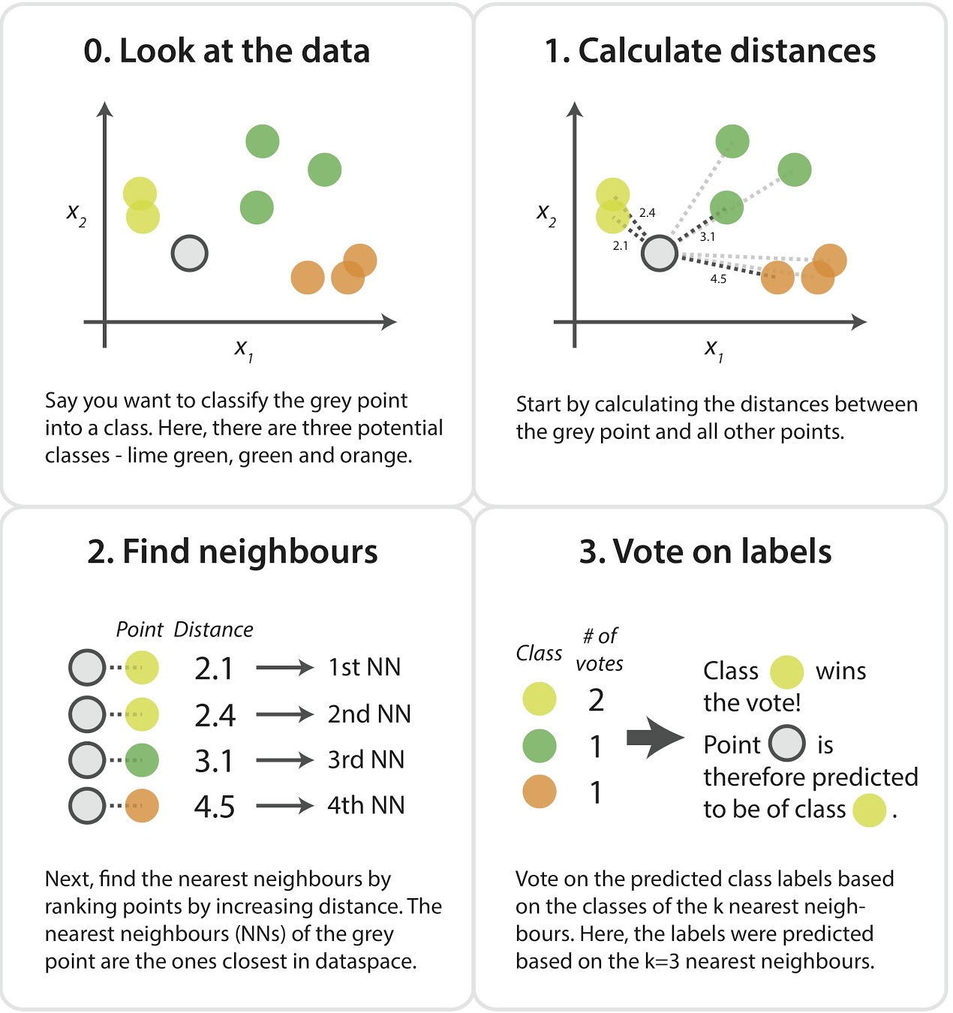
k-NN Algorithm

Slide 40
What Is Prediction?
(Numerical) prediction is similar to classification
construct a model
use model to predict continuous or ordered value for a given input
Prediction is different from classification
Classification refers to predict categorical class label
Prediction models continuous-valued functions
Major method for prediction: regression
model the relationship between one or more independent or predictor variables and a dependent or response variable
Regression analysis
Linear and multiple regression
Non-linear regression
Other regression methods: generalized linear model, Poisson regression, log-linear models, regression trees

Slide 41
Linear Regression
Linear regression: involves a response variable y and a single predictor variable x
y = w₀ + w₁ x
where w₀ (y-intercept) and w₁ (slope) are regression coefficients
Method of least squares: estimates the best-fitting straight line
Multiple linear regression: involves more than one predictor variable
Training data is of the form (X₁, y₁), (X₂, y₂),…, (X_{|D|}, y_{|D|})
Ex. For 2-D data, we may have: y = w₀ + w₁ x₁+ w₂ x₂
Solvable by extension of least square method or using SAS, S-Plus
Many nonlinear functions can be transformed into the above

Slide 42
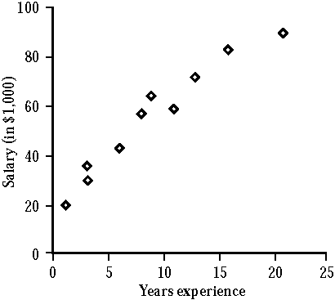
Example: Linear Regression
X (Years experience) | Y (Salary)
3 8 9 13 3 6 11 21 1 16 | 30K 57K 64K 75K 36K 43K 59K 90K 20K 83K
Given data
y = 23.6 + 3.5x

Slide 43

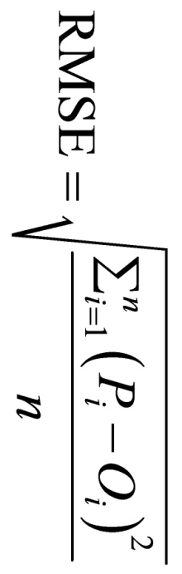
Example: Linear Regression Analysis
X (Years experience) | Y (Salary) | Y (Predicted) [Y=23.6 +3.5X] | Mean Absolute Error | Root Mean Squared Error
3 8 9 13 3 6 11 21 1 16 | 30K 57K 64K 75K 36K 43K 59K 90K 20K 83K | 34.1K 51.6K 55.1K 69.1K 34.1K 44.6K 62.1K 97.1K 27.1K 79.6K | abs(Y-Yp)=4.1 5.4 8.9 5.9 1.9 1.6 3.1 7.1 7.1 3.4 | Sqr(Y-Yp)=16.81 29.16 79.21 34.81 3.61 2.56 9.61 50.41 50.41 11.56
 |  |  | 4.85 | 5.37
Notes:
Abs(Y-Yp) = abs(30-34.1) = 4.1
Sqr(Y-Yp) = (30-34.1)*(30-34.1) = (-4.1)(-4.1) = 16.81

Slide 44
Q&A

